Slide 1
Mobile Device Management System(MDM)
Mobile Device Management (MDM) enables IT admins to securely monitor and manage the mobile devices that access sensitive business data. It includes storing essential information about mobile devices, deciding which apps can be present on the devices, locating devices, and securing devices if lost or stolen.

Slide 2
How to Build a Mobile Device Management (MDM) System
MDM system creates an additional layer of security, providing capabilities for monitoring any user activity on managed mobile devices. Additionally, an MDM system can provide device-specific and platform-specific functions related to:
data encryption
access management
secure digital card encryption
geolocation monitoring

Slide 3
Most MDM solutions are based on a client–server model. In this model, all management
commands are sent from the server to mobile devices, which then execute them.
Both client and server components can be developed separately and function
independently. However, when working on these components, you need to pay
special attention to the flexibility of their interfaces and to their data exchange protocols.

Slide 4
An MDM software platform detects devices connected to a network and sends them settings, commands, and configurations for immediate use. This process is fully
automated to ensure continuous device usage. An MDM system should store the
history of sent commands and the statuses of monitored devices. It should also be
able to provide the required level of management granularity by sending the necessary settings to all devices, to a particular group of devices, or to a specific device.
Devices connected to a network can be identified according to two parameters:
International Mobile Equipment Identity (IMEI) number
International Mobile Subscriber Identity (IMSI) number
An MDM system uses the IMEI to identify a particular device, while the IMSI determines
a SIM card that’s associated with a particular end user.

Slide 5
MDM Architecture
A classic mobile device management solution architecture consists of three layers:
Handset software
Middle-tier server
Backend server

Slide 6
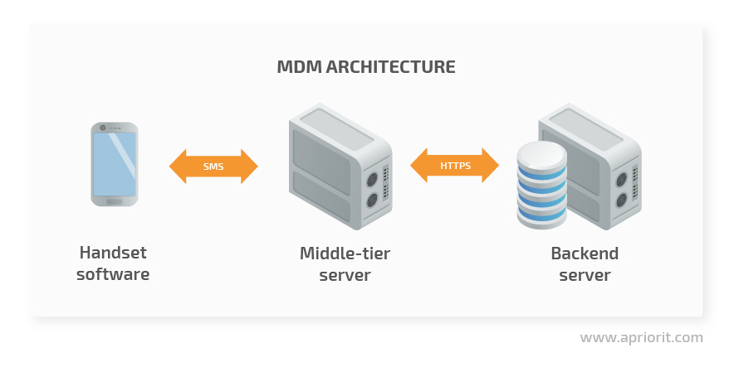

Slide 7
Middle-tier and backend (e.g. Firebase Cloud Messaging) servers communicate
via HTTPS using an API that provides commands for device management tasks such as:
locking mechanism activation and deactivation
checking activation status
locking and unlocking a device
sending push notifications
asynchronous request/retrieval of information about a device’s lock
status
A particular device is identified in the MDM server database based on its
phone number, IMEI, or IMSI (if it’s associated with a SIM card).

Slide 8
Client devices communicate with the middle-tier server via SMS. A client-side
certificate ensures the security of messages. The system stores a public key locally
on each device in a standard encrypted container used by the Android KeyChain API,
while SMSs from the server are signed with a private key.
The phone number through which the server sends and the client device receives and
sends messages is also stored on the device in a secure container. You can update this
container via SMS with a command sent from a valid phone number. Handset software
checks the validity of the phone number and verifies the SMS signature directly on the device

Slide 9
In order to fully cover how the backend server works, we’ll consider how it
interacts with its components. Take a look at the following mobile device
management architecture diagram.

Slide 10
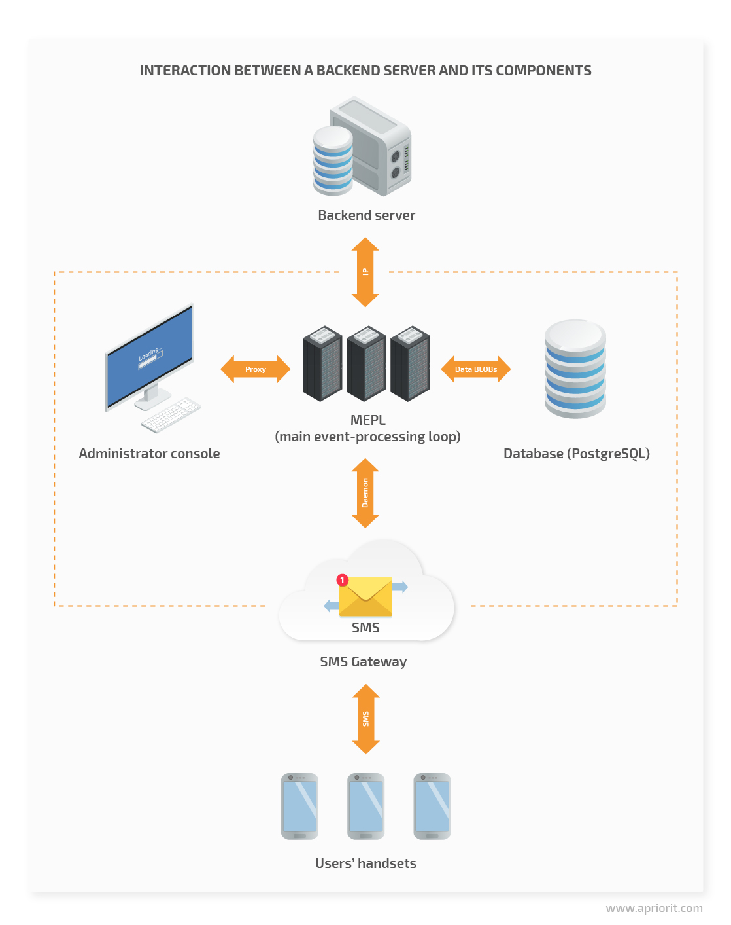

Slide 11
Main event-processing loop
The main event-processing loop (MEPL) receives requests and processes them
by calling other components in order to create messages, send it within the network
, and update the database. Therefore, the MEPL is a link that manages other
components.
The MEPL creates database requests for sent and received commands in the form
of binary large objects (BLOBs). The system stores BLOBs in a database such as
PostgreSQL. It’s important to store server–device command history in order to
monitor possible errors and collect user activity statistics.

Slide 12
SMS gateway
An SMS gateway allows the system to send and receive SMS messages
without an active phone number. Furthermore, the gateway can transform SMS
into email or HTTP requests, and vice versa. A message sent via an SMS gateway
is free for the sender. However, there can be some technical restrictions, such as
limits to the number of messages that can be sent from one computer per day.
It’s worth noting that in our example system, the gateway can work with the main
server via HTTP or HTTPS. Once the MEPL receives an HTTP request from the
gateway, it processes the message data, generates Short Message Peer-to-Peer
(SMPP) messages, and sends them back.

Slide 13
Administrator console
The administrator console is an interface that allows an administrator to
manage the system’s work. In our example, this console is implemented in
the form of a desktop application that communicates with the server via a
secure channel based on a proxy server. The administrator can use this
console for performing various actions, including:
analyzing work done on corporate devices
monitoring the activity of corporate devices
manually sending commands to mobile devices
detecting device usage violations
blocking particular functionality
The system sends the admin’s commands to the MEPL, then to devices and
the database via the SMS gateway.
The connection to Firebase Cloud Messaging or other similar services as well
as to other backend infrastructure that plays no significant role in device
management relies on an internet connection.

Slide 14
MDM architecture on the client side

Slide 15
In our sample MDM system, an Android application has several key functions:
Executing server commands
Reporting on server command statuses
Protecting corporate data
Limiting device functionality (up to full locking)
It’s noteworthy that in an MDM architecture, security is the main priority. If it’s
impossible to ensure absolute device and data security, we need to at least
make sure that hacking one device doesn’t make it easier to hack others
devices on the network.
Below, we overview the key elements to take into account when working on the
client side of an MDM system:
1. Device policy controller
2. Device owner and its alternatives
3. Unprovisioned and provisioned states

Slide 16
Device policy controller
A device policy controller (DPC) is an Android application that includes all the functions
mentioned above and manages access rights for system and client applications. A DPC
needs to be a system app in order to get all necessary privileges from the operating system
to manage other applications and their permissions.
Let’s see how we can handle this issue for non-rooted devices. We won’t consider
rooted devices, as our goal is to avoid having rooted devices in our network.

Slide 17
For non-rooted devices, the /system folders with system apps
(/system/app and /system/priv-app) have read-only access. You can
update system applications, but these updates won’t become part of
the ROM, and resetting the system to its default settings will delete
these applications.

Slide 18
Device owner
The device owner is the first user created during initial device configuration when the device is first
set up. The device owner is a privilege assigned to a certain application (MDM or another similar
solution) to enforce policies and restrictions on the target device.In case of already used devices,
you must remove all associated google accounts and factory reset the device.

Slide 19
Provisioned and unprovisioned states
The unprovisioned state is the state of a target device before the initial configuration.
The provisioned state, in turn, is the state of the configured device. For a corporate
device with a preinstalled DPC app, the device owner will be the DPC application itself.
Therefore, the DPC app will get access to advanced device management capabilities,
including:
hiding installed apps (both in the app list and in settings)
disabling the status bar
disabling notifications
disabling services such as Google Now and Google Assistant
preventing the display from switching off
silently installing and uninstalling apps
retrieving all necessary DPC runtime permissions
blocking the debugging mode (so that when connecting through USB, adb
doesn’t connect to the device)

Slide 20
What should you look for in a mobile device management system for your business?
An option to set up a fleet of devices in bulk
Device tracking
Device blocking and wiping functions
Device performance monitoring
Options for IoT device management
A free trial or a free demo for a risk-free assessment opportunity
Value for money in a system that provides a full mobile device management service at a fair price

Slide 21
11 Best Mobile Device Management (MDM) Solutions for 2022
1. ManageEngine Mobile Device Manager Plus (FREE TRIAL)

Slide 22
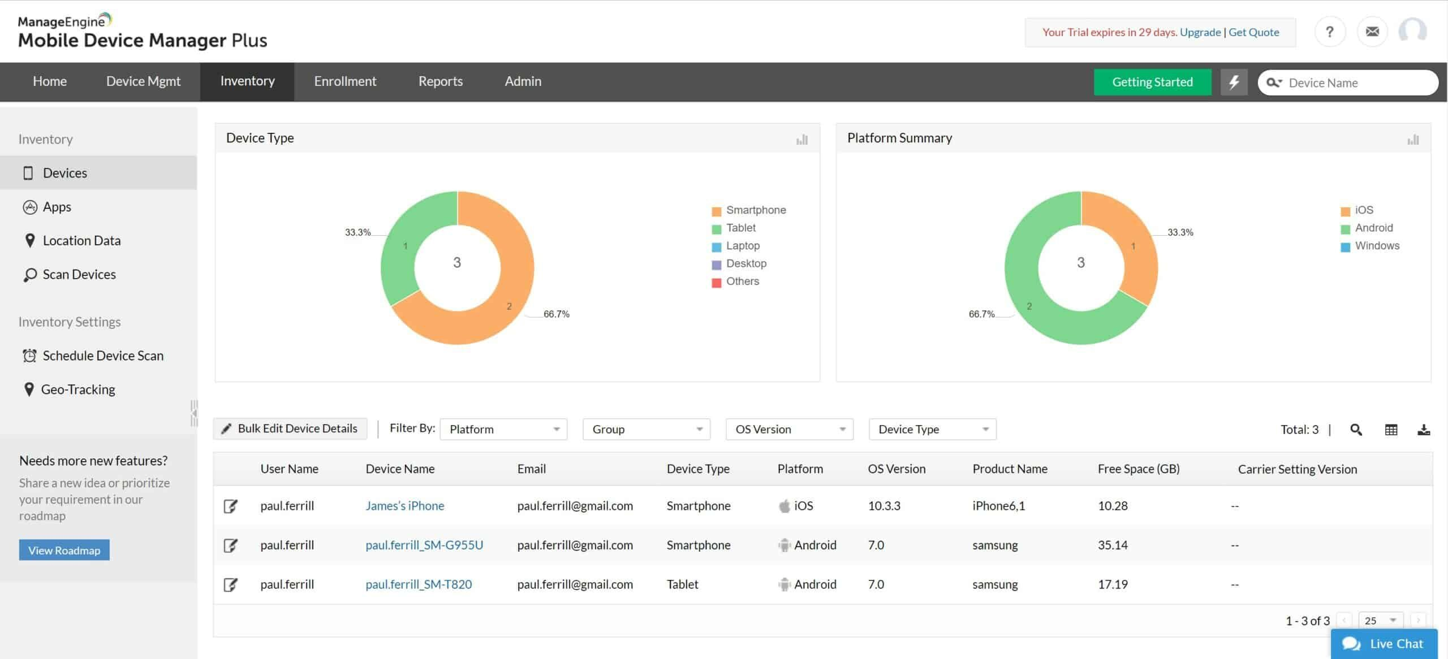

Slide 23
ManageEngine Mobile Device Manager Plus is a free MDM solution that can monitor desktop computers, laptops,
smartphones, and tablets. The software supports multiple operating systems including Windows, Mac OS,
Chrome OS, iOS, and Android. Through the customizable dashboard you can monitor mobile smart device status,
giving you complete visibility over the connected devices your employees bring to work.
Key features:
Supports Windows, Mac OS, Chrome OS, iOS, and Android.
Remote devicecontrol
Device scanning
Out-of-the-box reports

Slide 24
The mobile asset management experience offered by ManageEngine Mobile Device Manager Plus is very comprehensive.
The dashboard also enables you to view additional information on devices including device owners, installed applications,
and more. You can schedule regular device scans to keep this information updated.
If there are any problems with a device you can use remote troubleshooting to take control of the device and find the root
cause of the issue in real-time. The administrator can use a remote chat to communicate with the end-user of the device
. The chat can also be used to issue security commands.

Slide 25
ManageEngine Mobile Device Manager is recommended to enterprises who want a free mobile device management
solution. The software’s free for up to 25 devices. ManageEngine Mobile Device Manager Plus is available
on-premises (for Windows) and in the cloud. For pricing information, you must request a personalized quote
from the company directly.
OS used: Windows 7 or higher, Windows Server 2008 or higher

Slide 26
Pros:
Designed to work right away, features over 200 customizable widgets to build unique dashboards and reports
Leverages autodiscovery to find, inventory, and map new devices
Uses intelligent alerting to reduce false positives and eliminate alert fatigue across larger networks
Supports email, SMS, and webhook for numerous alerting channels
Integrates well in the ManageEngine ecosystem with their other products
Cons:
Is a feature-rich tool that will require a time investment to properly learn

Slide 27
2. Kandji (FREE TRIAL)
2. Kandji (FREE TRIAL)

Slide 28
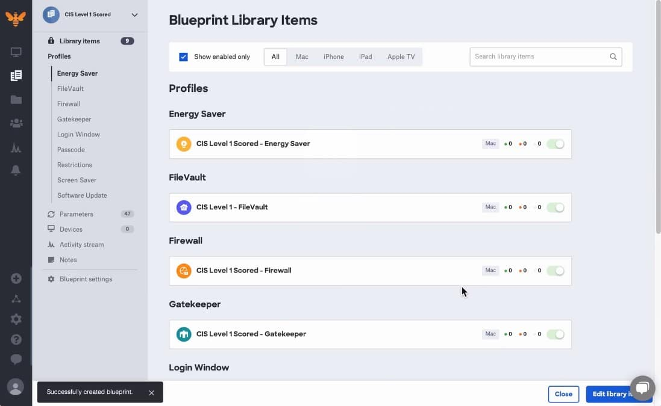

Slide 29
Kandji.io specializes in the management of Apple devices. This includes
desktop Macs and mobile devices
Key features:
Macs and mobile devices
Onboarding features
Patching
Data privacy standards compliance

Slide 30
Pros:
Integrates with third-party systems to create a single sign-on environment
Allows the creation of Blueprints, which are software profiles for groups of
devices
Lets users switch between on-premises Macs and mobile devices
Automated the update of software and operating systems
Cons:
Won’t manage devices running Windows, Linux, or Android.

Slide 31
3. VMWare Workspace ONE
3. VMWare Workspace ONE

Slide 32
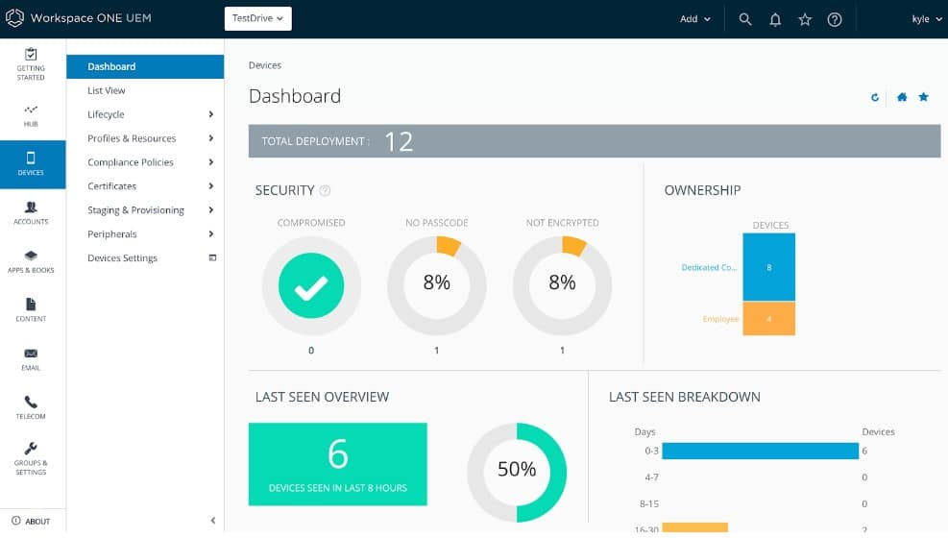

Slide 33
Key features:
Configure devices on bulk
Automatically deploy applications
Use onboarding workflow to add new devices
The platform also enables you to automatically push applications to devices

Slide 34
4. BlackBerry Unified Endpoint Management
4. BlackBerry Unified Endpoint Management

Slide 35
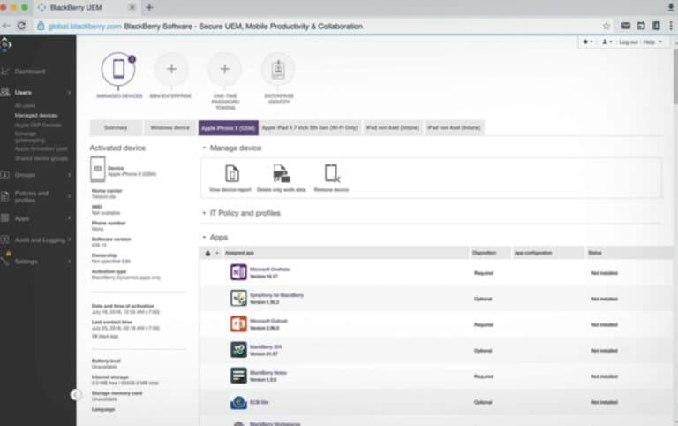

Slide 36
Key features:
Manage device policies
Supports iOS, Android, Chrome OS, Windows, and Mac OS
Activate uses with a QR code (iOS and Android only)
Available on-Premises and in the cloud

Slide 37
5. Citrix Endpoint Management
5. Citrix Endpoint Management

Slide 38
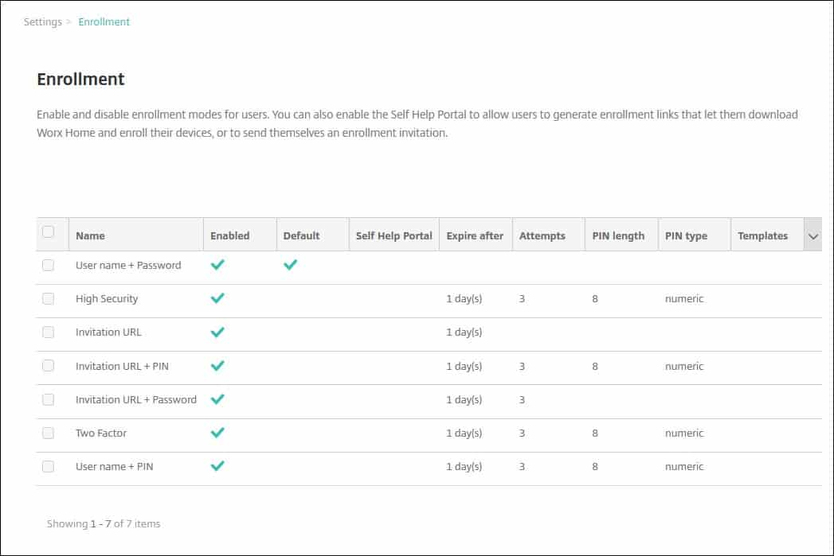

Slide 39
Citrix Endpoint Management is one of the top MDM solutions that enable users to
monitor devices, applications, and platforms from one console. With Citrix Endpoint
Management you can monitor Windows 10, Mac OS, iOS, tvOS, iPadOS, Android
, Android Enterprise, Chrome OS, and Citrix.
Key features:
Remote monitoring & device management
Machine learning and Analytics
Integrations with Azure Active Directory and Okta

Slide 40
6. SOTI MobiControl
6. SOTI MobiControl

Slide 41
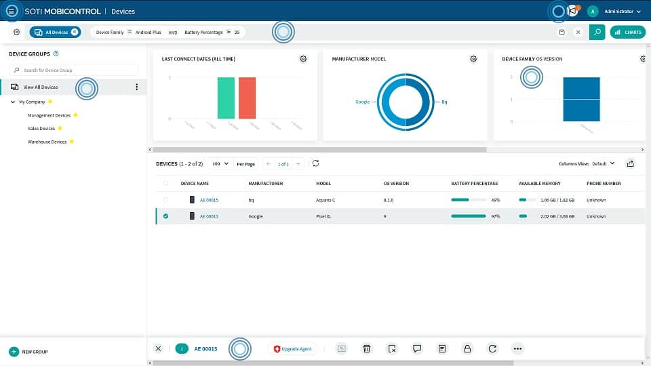

Slide 42
SOTI MobiControl is an endpoint management solution that can monitor devices from over
170 vendors in one location. Devices supported by SOTI MobiControl include Windows XP, Windows CE, Mac OS, iOS, and Android.
Key features:
Remote viewing
Remote control
Integrations with Apple DEP, Android zero-touch enrolment, Samsung KME, Windows
Autopilot, and Zebra StageNow
Use scripts to execute management actions

Slide 43
7. IBM MaaS360
7. IBM MaaS360

Slide 44
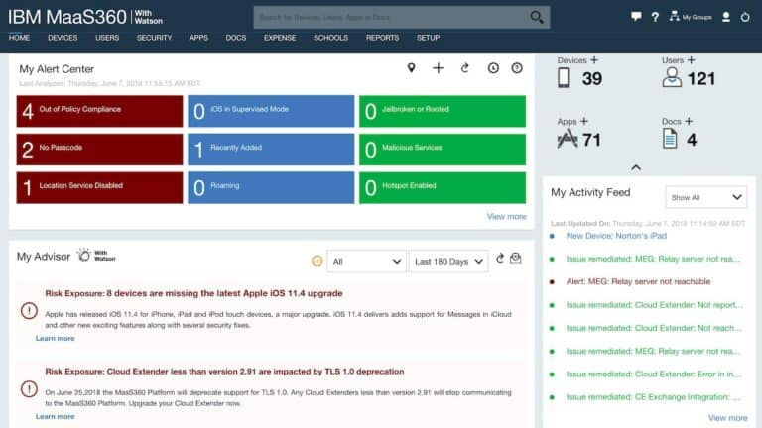

Slide 45
IBM MaaS360 is an enterprise mobility management solution that supports Windows,
Mac OS, Android, and iOS devices. With IBM MaaS360 you can monitor the data
usage of devices in real-time and deploy updates to mobile applications from one
centralized location. Application updates can be deployed to Windows and Mac
OS devices for apps like Java, Adobe, Flash, Apple iTunes, and more.

Slide 46
Key features:
Real-time data usage monitoring
Malware detection and remediation
24/7/365 customer support
Single sign-on to web and cloud apps

Slide 47
8. Cisco Meraki
8. Cisco Meraki

Slide 48
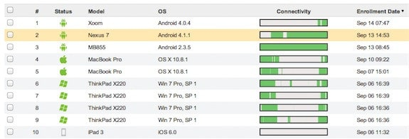

Slide 49
Cisco Meraki covers the management of laptops and desktops as well as smartphones
and tablets. This management console of this system is very attractive and includes
a map showing the locations of all of your company’s managed devices. However,
it can’t manage IoT or wifi-enabled office equipment, such as printers. It will
communicate with devices running Windows, macOS, Windows Phone, iOS,
Android, Chrome OS and Samsung Knox.Lost or stolen mobile phones can have all of
their rights revoked and can be locked or wiped remotely

Slide 50
9. Miradore Mobile Device Management
9. Miradore Mobile Device Management

Slide 51
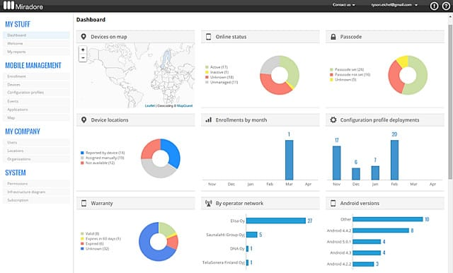

Slide 52
Offers three flexible pricing options
Encrypts communications via VPN
Provides security features as an add on

Slide 53
10. SimplySecure
11. SimplySecure

Slide 54
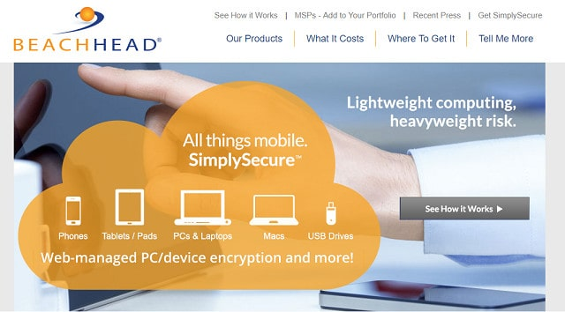

Slide 55
SimplySecure is a cloud-based MDM capable of dealing with iOS and Android
mobile devices and portable storage. The overall service is called the
SimplySecure Management System and it can cover desktops, laptops
, mobile devices, and USB storage in these different pricing categories.
The dashboard for the service is accessed via web browser. Configure
your mobile devices remotely and in bulk, applying different policies to
groups of devices. Lost devices can be wiped remotely and devices that
display suspicious activity can be quarantined.

Slide 56
Complete List
ManageEngine Mobile Device Manager Plus: Mobile device management
solution for device management that supports Windows, Mac OS, Chrome
OS, iOS, and Android. A complete enterprise device management package
with both on-premises and cloud-based versions.
Kandji : A cloud-based service that reaches out to devices through agents and
specializes in Apple devices.
VMWare Workspace ONE Mobile device management solution that can configure
policies for devices remotely, automatically deploy applications, and more.

Slide 57
BlackBerry Unified Endpoint Management :Endpoint management solution design that
supports Windows 10, Mac OS, iOS, Android, and Chrome OS.
Citrix Endpoint Management :MDM solution that supports Windows 10, Mac OS, iOS,
tvOS, iPadOS, Android, Android Enterprise, Chrome OS, and Citrix.
SOTI MobiControl :Endpoint management software that supports Windows XP, Windows
CE, Mac OS, iOS, and Android.
IBM MaaS360 : Enterprise mobility management solution with real-time data usage
monitoring, application updates, endpoint device malware detection, and more.

Slide 58
Cisco Meraki :Includes a container system to deliver apps to user-owned devices
and also has loss protection procedures.
Miradore Mobile Device Management :A Cloud-based device manager in both free
and paid versions.
SimplySecure :A cloud-based MDM that covers iOS and Android mobile devices
and portable storage.

Slide 59
Thank You

